Slide 1
CHAPTER 6
OPTION PRICING

Slide 2
Outline
Binomial trees
Black-Scholes Pricing Formulas

Slide 3
Valuation of options - Binomial trees
A useful and very popular technique for pricing an option involves constructing a binomial tree.
This is a diagram representing diffrent possible paths that might be followed by the stock price over the life of an option.
Base on no-arbitrage arguments and a principle of risk neutral valuation.

Slide 4
A Simple Binomial Model
A stock price is currently $20 → Underlying asset
In 3 months it will be either $22 or $18
Price of a call option of this stock, T=3 months
Stock Price = $22
Stock price = $20
Stock Price = $18

Slide 5
A Call Option
A 3-month call option on the stock has a strike price of 21. Port has 2 positions: long delta shares +short 1 call.
Stock Price = $22
Option Price = $1
Stock price = $20
Option Price=?
Stock Price = $18
Option Price = $0

Slide 6
Setting Up a Riskless Portfolio
Consider the Portfolio: long Δ shares short 1 call option
Portfolio is riskless when 22Δ – 1 = 18Δ or
Δ = 0.25
22Δ – 1
18Δ

Slide 7
Valuing the Portfolio (Risk-Free Rate is 12%)
The riskless portfolio is:
long 0.25 shares short 1 call option
The value of the portfolio in 3 months is 22 × 0.25 – 1 = 4.50
The value of the portfolio today is
4.5e ^{– 0.12×0.25} = 4.3670

Slide 8
Valuing the Option
The portfolio that is
long 0.25 shares short 1 option
is worth 4.367
The value of the shares is 5.000 (= 0.25 × 20 )
The value of the option is therefore 0.633 (= 5.000 – 4.367 )

Slide 9
Generalization (a)
A derivative lasts for time T and is dependent on a stock
S₀u
ƒ_{u}
S₀
ƒ
S₀d
ƒ_{d}

Slide 10
Generalization (b)
Consider the portfolio that is long Δ shares and short 1 derivative
The portfolio is riskless when S₀uΔ – ƒ_{u} = S₀dΔ – ƒ_{d} or
S₀uΔ – ƒ_{u}
S₀dΔ – ƒ_{d}

Slide 11
Generalization (c)
Value of the portfolio at time T is S₀uΔ – ƒ_{u}
Value of the portfolio today is (S₀uΔ – ƒ_{u})e^{–rT}
Another expression for the portfolio value today is S₀Δ – f
Hence ƒ = S₀Δ – (S₀uΔ – ƒ_{u} )e^{–rT}

Slide 12
Generalization (d)
Substituting for Δ we obtain
ƒ = [ pƒ_{u} + (1 – p)ƒ_{d} ]e^{–rT}
where

Slide 13
p as a Probability
It is natural to interpret p and 1-p as probabilities of up and down movements
The value of a derivative is then its expected payoff in a risk-neutral world discounted at the risk-free rate
S₀u
ƒ_{u}
p
S₀
ƒ
S₀d
ƒ_{d}
(1 – p )

Slide 14
Risk-Neutral Valuation
When the probability of an up and down movements are p and 1-p the expected stock price at time T is S₀e^{rT}
This shows that the stock price earns the risk-free rate
Binomial trees illustrate the general result that to value a derivative we can assume that the expected return on the underlying asset is the risk-free rate and discount at the risk-free rate
This is known as using risk-neutral valuation

Slide 15
Original Example Revisited
S₀u = 22
ƒ_{u} = 1
Since p is the probability that gives a return on the stock equal to the risk-free rate. We can find it from
20e^{0.12 ×0.25} = 22p + 18(1 – p )
which gives p = 0.6523
Alternatively, we can use the formula
p
S₀
ƒ
S₀d = 18
ƒ_{d} = 0
(1 – p )

Slide 16
Valuing the Option Using Risk-Neutral Valuation
The value of the option is
e^{–0.12×0.25} (0.6523×1 + 0.3477×0)
= 0.633
S₀u = 22
ƒ_{u} = 1
0.6523
S₀
ƒ
S₀d = 18
ƒ_{d} = 0
0.3477

Slide 17
A Two-Step Example
Each time step is 3 months
K=21, r=12%
24.2
22
20
19.8
18
16.2

Slide 18
Valuing a Call Option
Value at node B is
e^{–0.12×0.25}(0.6523×3.2 + 0.3477×0) = 2.0257
Value at node A is
e^{–0.12×0.25}(0.6523×2.0257 + 0.3477×0) = 1.2823
24.2
3.2
D
22
B
20
1.2823
2.0257
19.8
0.0
A
E
18
C
0.0
16.2
0.0
F

Slide 19
Ex: Consider a 2-year European put with a strike price of $52 on a stock whose current price is $50. Suppose that there two time steps of 1 year, and in each time step the stock price either moves up by 20% or moves down by 20%. The risk-free rate is 5% per annum.
u =1.2, d =0.8

Slide 20
A Put Option Example Figure 11.7, page 246
K = 52, time step =1yr
r = 5%
72
0
D
60
B
50
4.1923
1.4147
48
4
A
E
40
C
9.4636
32
20
F

Slide 21
What Happens When an Option is American
72
0
D
60
B
50
5.0894
1.4147
48
4
A
E
40
C
12.0
32
20
F

Slide 22
Delta
Delta (Δ) is the ratio of the change in the price of a stock option to the change in the price of the underlying stock
The value of Δ varies from node to node
The number of units of stock we should hold for each option shorted in ordered to create a riskless portfolio.

Slide 23
Problems
1. A stock price is currently $40. It is known that at the end of 1 month, it will be either $42 or $38. The risk-free rate is 8% per annum with continuous compounding. What is the value of a 1-month European call option with a strike price of $39?
2. A stock price is currently $50. It is known that at the end of 6 months, it will be either $45 or $55. The risk-free rate is 10% per annum with continuous compounding. What are the values of a 6-month European call option and a 6-month European put with a strike price of $50? Verify that the European call and European put prices satisfy put-call parity.

Slide 24
3. A stock price is currently $100. Over each of the next two 6-month periods it is expected to go up by 10% or down by 10%. The risk-free rate is 8% per annum with continuous compounding. What is the value of a 1-year European call option with a strike price of $100?
4. A stock price is currently $50. Over each of the next two-3month periods it is expected to go up by 6% or down by 5%. The risk-free interest rate is 5% per annum with continuous compounding. What is the value of a 6-month European call option with a strike price of $51?

Slide 25
5. A stock price is currently $80. It is known that at the end of 4 months it will be either $75 or $85. The risk-free rate is 5% per annum with continuous compounding. What is the value of a 4-month European put option with a strike price of $80.
6. A stock price is currently $40. It is known that at the end of 3 months it will be either $45 or $35. The risk-free rate is 8% per annum with continuous compounding. What is the value of a 3-month European put option with a strike price of $40?

Slide 26
7. A stock price is currently $40. Over each of the next two 3-month periods, it is expected to go up by 10% or down by 10%. The risk-free rate is 12% per annum with continuous compounding. What is the value of a 6-month European put option with a strike price of $42?

Slide 27
The Stock Price Assumption
Consider a stock whose price is S
In a short period of time of length Δt, the return on the stock is normally distributed:
where μ is expected return and σ is volatility

Slide 28
The Expected Return
The expected value of the stock price is S₀e^{μT}
The expected return on the stock is
μ – σ²/2 not μ
This is because
are not the same

Slide 29
The Black-Scholes Formulas (See chapter 13, pages 291-293)

Slide 30
The N(x) Function
N(x) is the cumulative probability distribution function for a standardized normal distribution
N(x) is the probability that a normally distributed variable with a mean of zero and a standard deviation of 1 is less than x
NORMSDIST in Excel
Notes:
NORMSDIST in excel

Slide 31
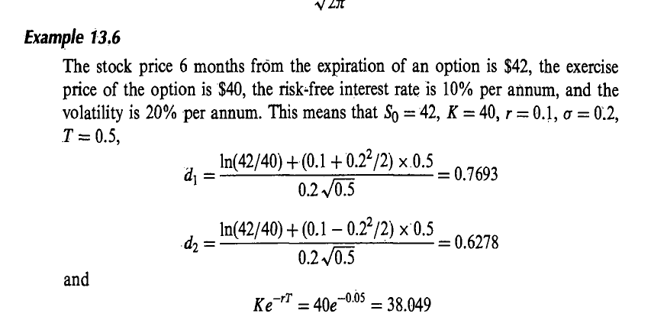
Example

Slide 32
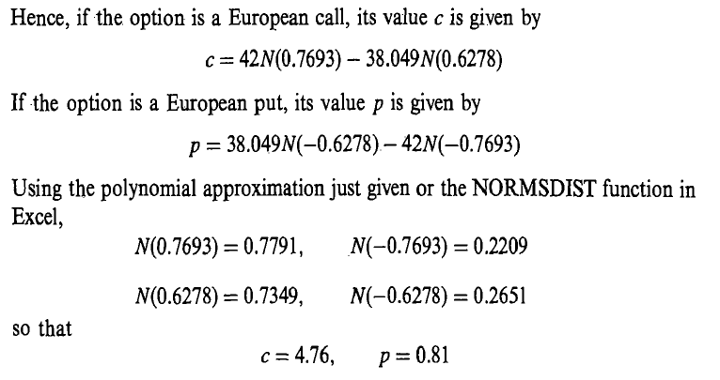
Example

